Slide 1
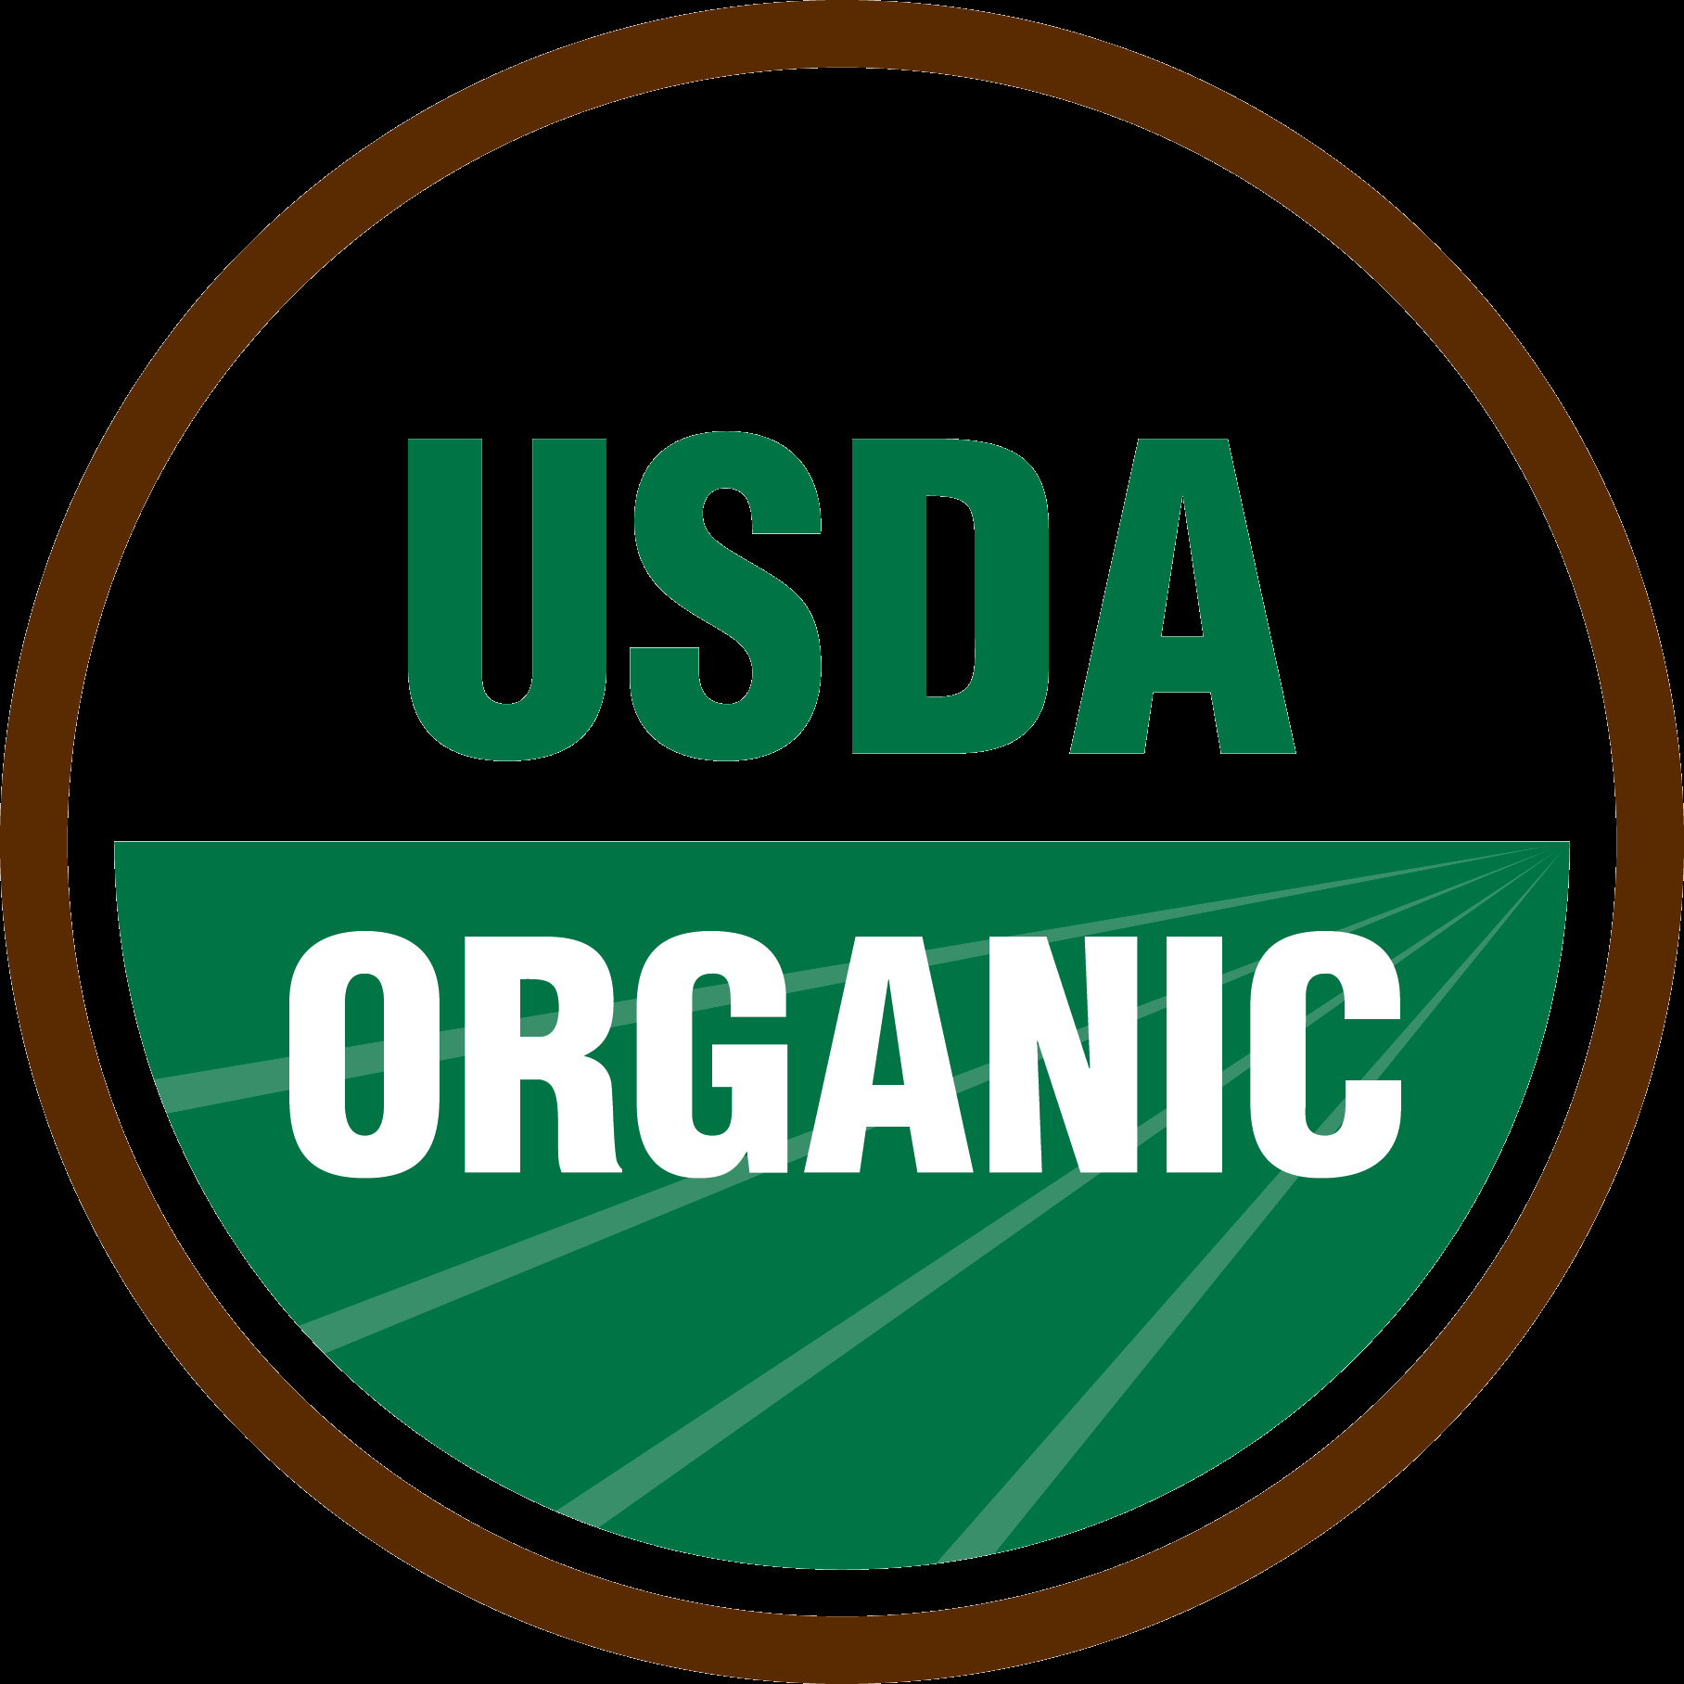
Organic Agriculture Production
Mr. Bailey
Agri-science

Slide 2
Table Partner Work
Answer the following:
What is organic produce?
How is organic produce grown?
You have 2 minutes to complete this
http://ofrf.org/organic-faqs

Slide 3
Taste Test!!!
There are two types of apples you will taste
Apple A & B
After you taste both write down which apple you liked the best.
Class Vote – Apple A or B

Slide 4
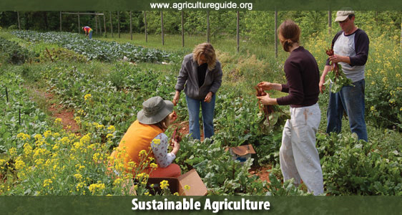
What is meant by the word “organic”?
Food produced with the use of feed or fertilizer of plant or animal origin
Without employment of chemically formulated fertilizers, growth stimulants, antibiotics, or pesticides
Created in the early 1920’s developed a big boom in the early 2000’s

Slide 5
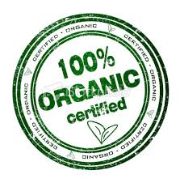
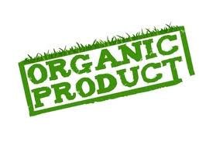
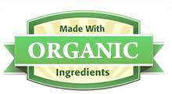
Are there different types of “organic”?
100% organic – food contains only organically produced ingredients (USDA Organic seal)
Organic - these products contain at least 95% organically produced ingredients
Made with organic ingredients - Food packaging must contain at least 70% organic ingredients

Slide 6
What is the difference between “certified” organic and organically grown?
Certified – means they are meeting the standards set forth by the USDA and National Organic Program (organic system plan) and maintain the requirements set forth
Organically grown – means they are producing food according to the requirements but have not yet received their certification

Slide 7
How do I become a “certified” organically grown producer?
http://www.ecfr.gov/cgi-bin/text-idx?c=ecfr&SID=8043dfc777918d8fbda3a51ff6ddad97&rgn=div6&view=text&node=7:3.1.1.9.32.3&idno=7

Slide 8
What are the benefits of growing organic produce?
More money
Cuts down on environmental damage
Uses natural fertilizers and pesticides from the environment
Promote biodiversity

Slide 9
Exit Slip
Differentiate between “certified” organic and organically grown.
List one benefit of growing organic produce.

