Slide 1
The Meat Industry
Mr. Bailey
Agri-Science

Slide 2
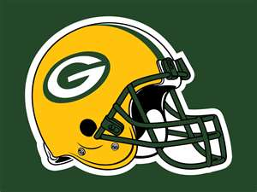
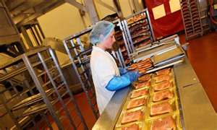
Green Bay Packers?
Not just a football team
Name came from the meat packers in the area
Meat packer – someone who packs/wraps meat

Slide 3
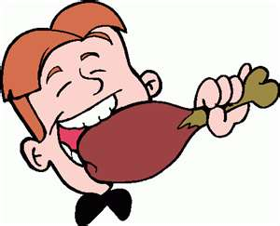
Main Purpose of Meat Industry
Raise quality animals
Quality animals provide essential nutrients for a good diet

Slide 4
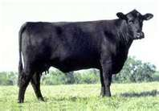
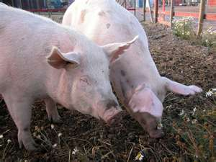
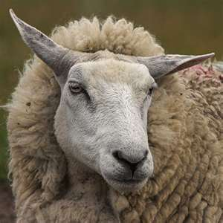
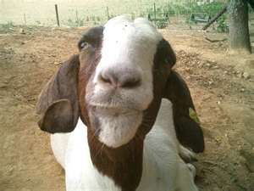
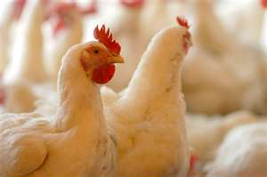
Meat Animals…YUM!
Beef Cattle
Sheep/Goats
Hogs
Poultry

Slide 5
Why is the Meat Industry Important?
Americans are meat eaters
97 lbs. of beef, 64 lbs. of pork, 90 lbs. of poultry
U.S. consumes 11.4% of world meat production

Slide 6
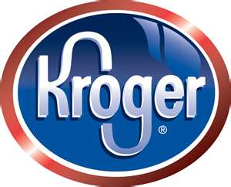
Important to Kentucky?
Calves raised here sold to feed lots in Mid-West
Then processed and shipped back here
(i.e. Kroger, Meijer, Wal-Mart)
Growing population of meat goats

Slide 7
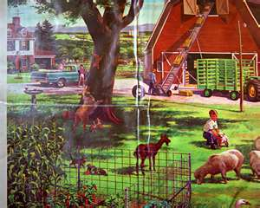
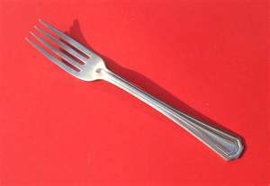
From Farm to Fork
Producing
Transporting
Processing
Packaging
Distributing
Marketing

Slide 8
In Class Activity
Illustrate the processing steps of the meat industry
Come full circle on your illustrations
You have 10 minutes

Slide 9
Your Task!!!!
Marketing is a very important part in the Meat Industry
You are marketing specialist and your “team” will come up with an advertisement

Slide 10
Your Advertisement
You will be in pre-decided groups
You will receive a meat item or animal from Mr. Bailey

Slide 11
Your Advertisement Should Include…
Name of meat item
Why people should buy it
(i.e. low in Fat, high in Vitamins, low in Cholesterol, etc.)
Average cost of item

Slide 12
Ways to Advertise…
Sales Poster (pictures, information, etc.)
Song (2 minutes)
Jingle (2 minutes)
Rap (2 minutes)
Radio Commercial (2 minutes)
TV Commercial (2 minutes)
Other ideas? (Must be approved by me)

Slide 13
Your job now…
Choose which way you want to advertise
Start creating a skit
(Everyone must participate in skit)
Research your meat item

