Slide 1
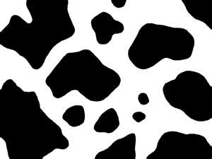
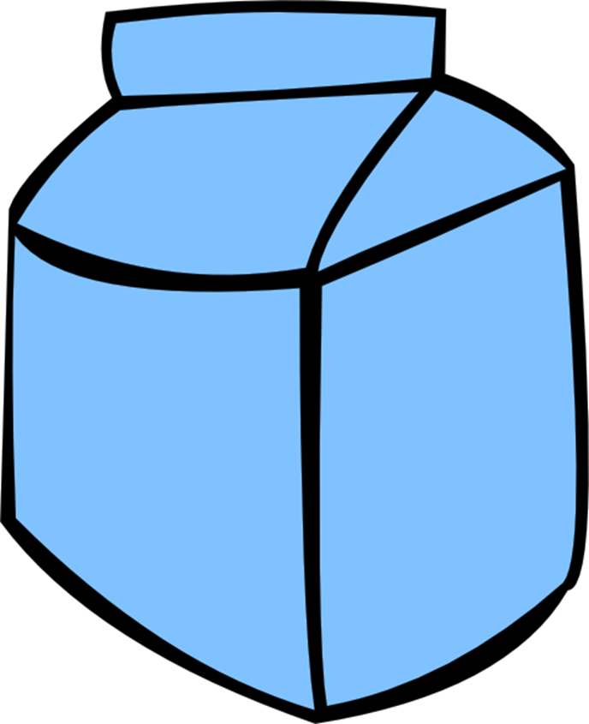
The
Dairy
Industry
Mr. Bailey
Agri-Science

Slide 2
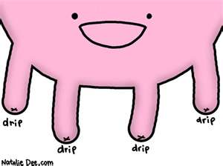
Where does the milk come from?
Process of producing milk is called lactation
Occurs after birth of a calf
Milk production occurs in the udder

Slide 3
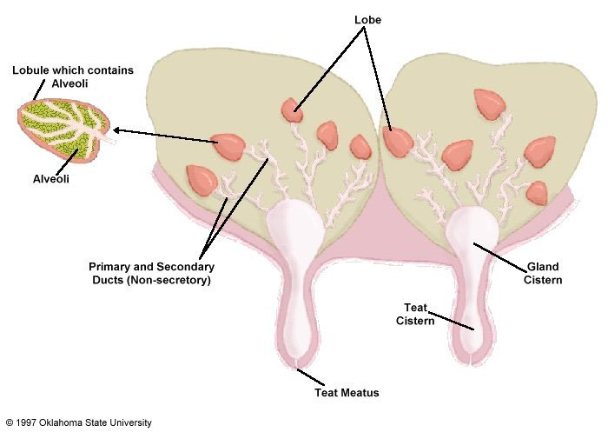
Mammary Gland (Udder)

Slide 4
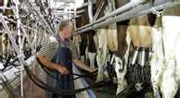
How do I get the milk out?
Cows are milked by machines
Udder is cleaned before and after milking
Helps to avoid contamination

Slide 5
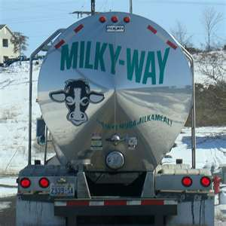
Milk- “I’m going on a trip”
Goes to processing plant
Checked for bacteria and infection
Sits for cream to raise and be removed
Cream contains fat

Slide 6
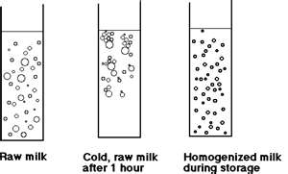
Milk- “What happens when I get the plant.”
Homogenization- large cream globules are reduced to the size of the milk globules
Homogenized milk – cream will not separate from the milk

Slide 7
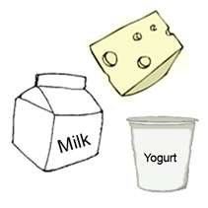
Milk- “What’s next.”
Pasteurization- milk is heated and cooled to kill any harmful organisms
Grading
A – beverage milk
B – manufacturing dairy products (cheese, butter, yogurt)

Slide 8
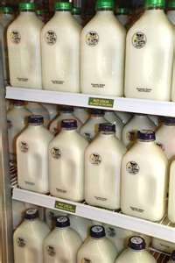
The Difference in Milk
Whole milk- contains fat
2% - contains some fat
1% - contains little fat
Skim- contains no fat
A gallon of milk weights between 8.5 - 8.8 lbs. depending on fat content.

Slide 9
Milk Processing Video
http://www.bing.com/videos/search?q=how+is+milk+processed&view=detail&mid=0B63C31979253215D8610B63C31979253215D861&first=41

Slide 10
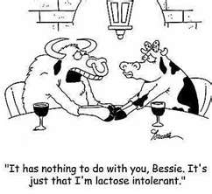
Common Breeds of Dairy Cattle
Holstein – 90% of U.S. dairy cattle
Jersey – high in butterfat and protein
Guernsey
Brown Swiss

Slide 11
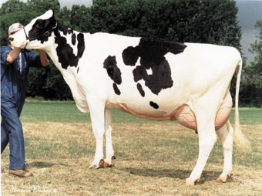
Holstein

Slide 12
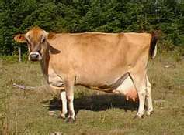
Jersey

Slide 13
Exit Slip
Identify the process milk takes from the farm to what you buy in the store based on the information learned today.

