Slide 1
Animal Evaluation
Mr. Bailey
Agri-Science

Slide 2
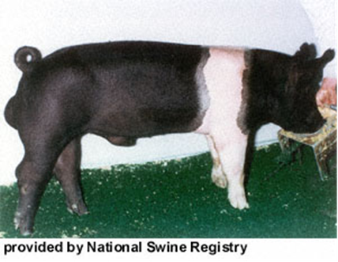
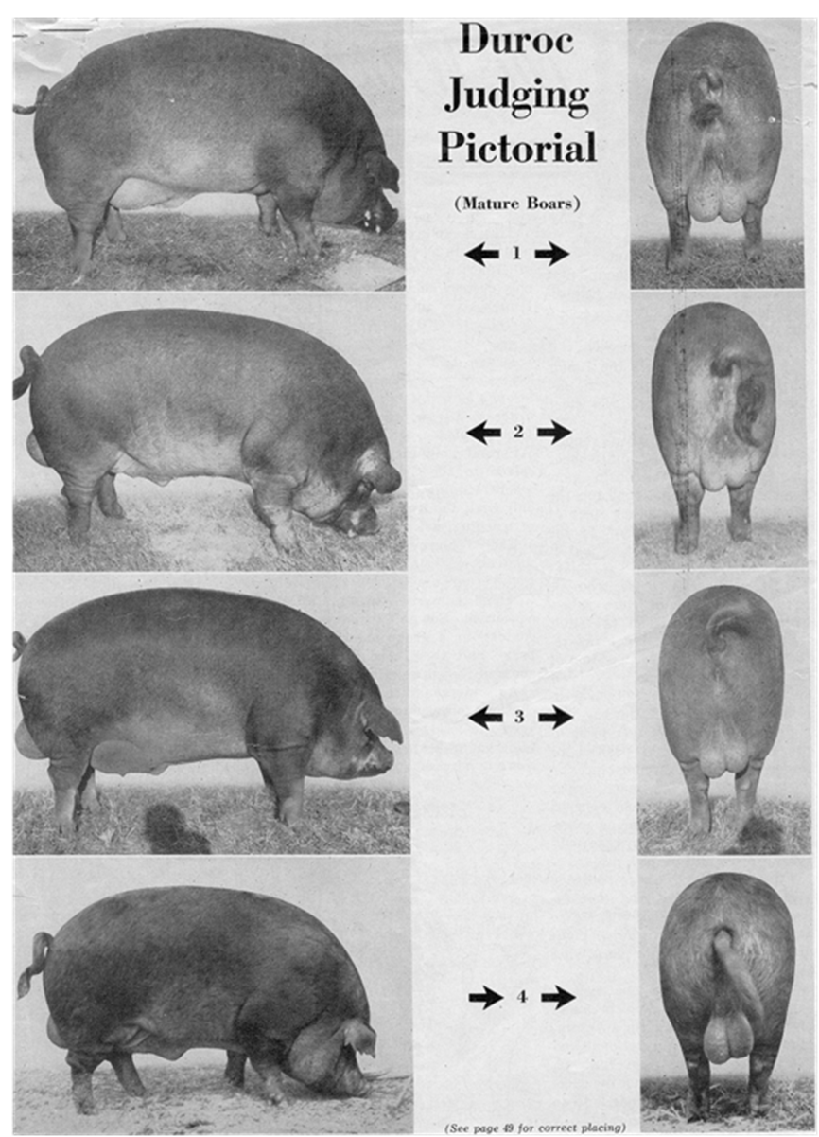
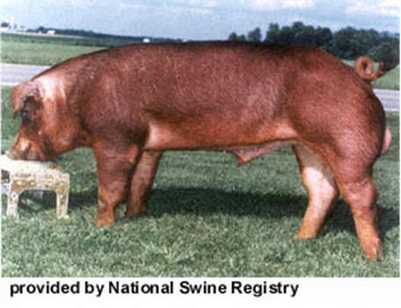
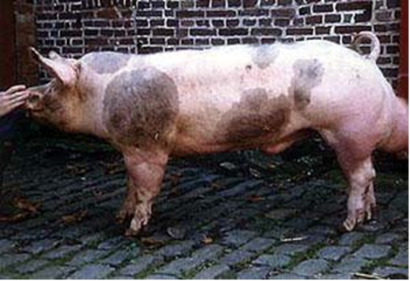
Bell Ringer
Present Day
1954

Slide 3
How where the Hogs different?
1954 hogs where fatter
Hogs today are slender
We want hogs today to have more muscle
We know the dangers of fat related diseases

Slide 4

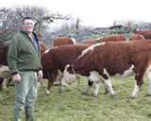
Animal Evaluation
More than just judging a class of animals
Involves making decisions about quality animals
Evaluation used to improve livestock used in today’s industry

Slide 5
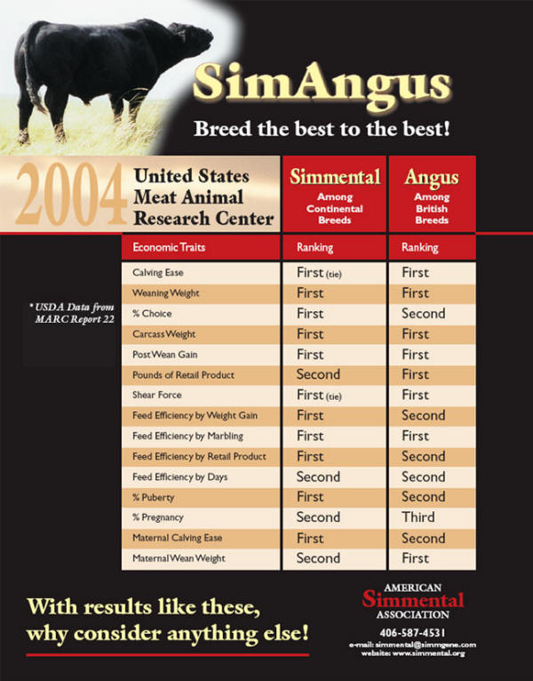
Why is Evaluation important?
Used to improve the livestock industry
Through selection of certain traits & characteristics animals have evolved

Slide 6
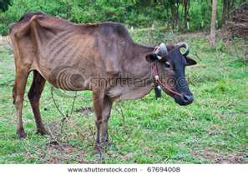
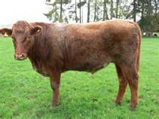
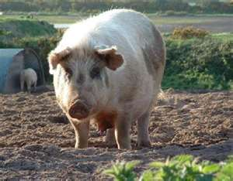
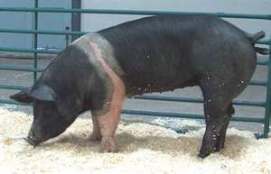
Two Main Functions of Animal Selection
To improve the quality of offspring
To provide better quality animal products

Slide 7
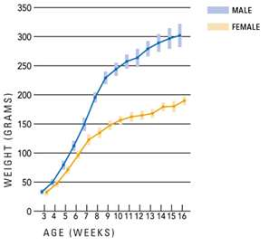
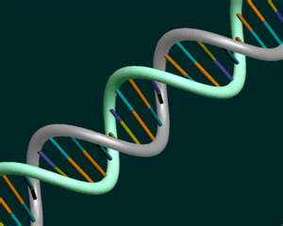
What quality are sought when selecting animals
Reproduction ability – continually produce offspring
Growth capabilities – ability of animal to grow rapidly
Efficiency – grow rapidly without wasting feed

Slide 8
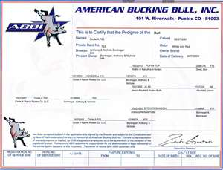
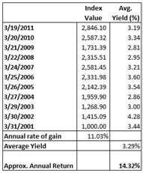
How are Animals Evaluated
Pedigree
Production testing
Type and individuality

Slide 9
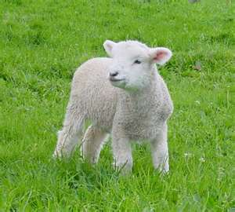
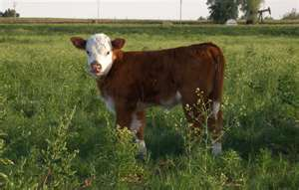
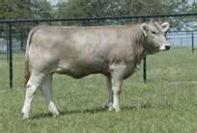
How to select Breeding Animals
Used to reproduce and improve the herds
Traits selected for breeding are ones that will produce a better offspring

Slide 10
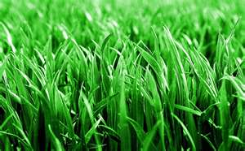
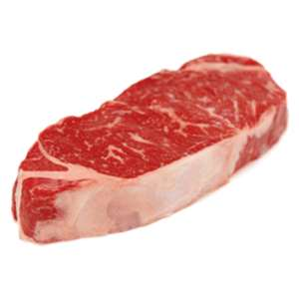
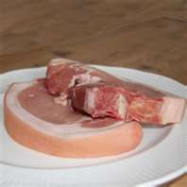
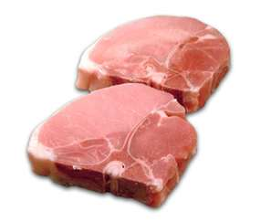
How to select Marketing Animals
Looks at how well the animal can convert food to muscle
Animals that are too fat will not produce quality meat

Slide 11
Exit Slip
Explain the selection difference for market animals and breeding animals.
Identify the functions used when selecting breeding animals.
Do this individually!

Slide 12
How well can you judge animals
Work with your table partner and judge the different animals
Practice placing the animals from best to worst
This is what people do everyday and why your food is GOOOOOOOOD!!!!!!!!!!!

Slide 13
Market Beef Cattle
A
B

Slide 14
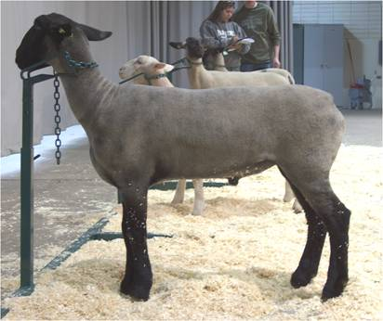
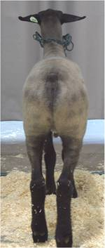
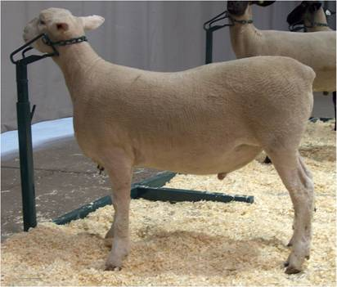
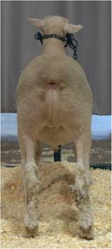
Market Lambs
A
B

